Slide 1

Policy Function Approximation /
Policy Gradient Methods
From value-based methods to policy-based methods
From value function approximation to policy function approximation
Bellman 方程/Bellman最优方程 -> v(s),q(s,a) ➔ 评估当前策略
利用q(s,a) upgrade 策略 ➔ 优化更新策略
2023/5/7
MICL in USTB

Slide 2

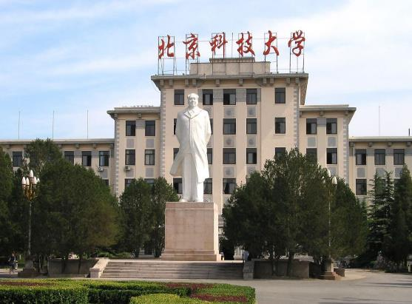
1
Basic idea of policy gradient
2*
Metrics to define optimal policies
3
Gradients of the metrics
4
Gradient-ascent algorithm （REINFORCE）
5
Policy-based algorithms
6
Summary

Slide 3
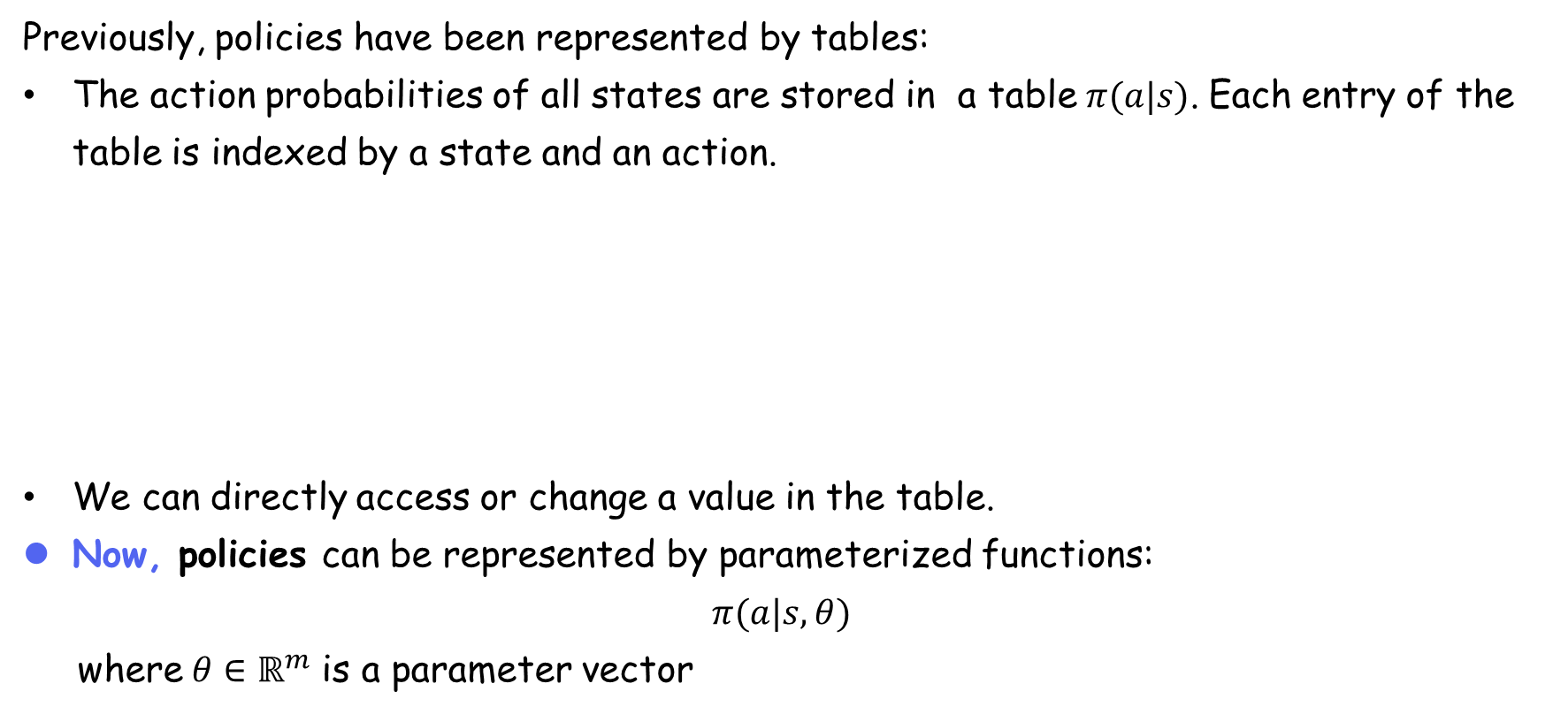
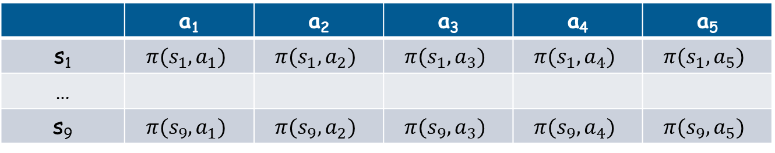
Basic idea of policy gradient
Previously, policies have been represented by tables:
The action probabilities of all states are stored in a table$π(a|s)$. Each entry of the table is indexed by a state and an action.
We can directly access or change a value in the table.
Now, policies can be represented by parameterized functions:
$$π(a|s,θ)$$
where$θ∈ℝ^{m}$ is a parameter vector
 | a₁ | a₂ | a₃ | a₄ | a₅
s₁ | $$π(s_{1},a_{1})$$ | $$π(s_{1},a_{2})$$ | $$π(s_{1},a_{3})$$ | $$π(s_{1},a_{4})$$ | $$π(s_{1},a_{5})$$
…
s₉ | $$π(s_{9},a_{1})$$ | $$π(s_{9},a_{2})$$ | $$π(s_{9},a_{3})$$ | $$π(s_{9},a_{4})$$ | $$π(s_{9},a_{5})$$

Slide 4
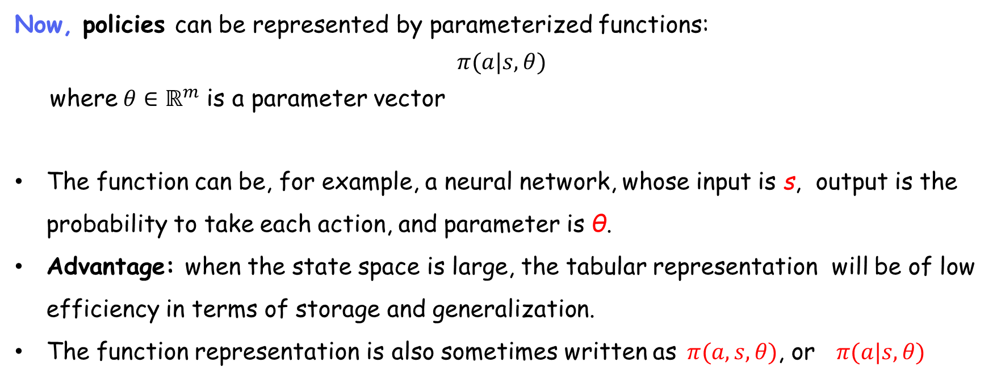
Basic idea of policy gradient
Now, policies can be represented by parameterized functions:
$$π(a|s,θ)$$
where$θ∈ℝ^{m}$ is a parameter vector
The function can be, for example, a neural network, whose input is s, output is the probability to take each action, and parameter is θ.
Advantage: when the state space is large, the tabular representation will be of low efficiency in terms of storage and generalization.
The function representation is also sometimes written as$π(a,s,θ)$, or $π(a|s,θ)$

Slide 5
Basic idea of policy gradient
Differences between tabular and function representations:
First, how to define optimal policies?
When represented as a table, a policy π is optimal if it can maximize every state value.
When represented by a function, a policy π is optimal if it can maximize certain scalar metrics.

Slide 6
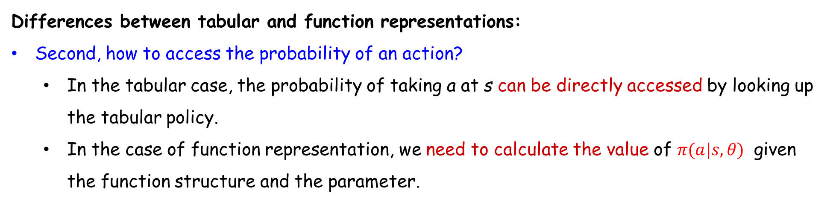
Basic idea of policy gradient
Differences between tabular and function representations:
Second, how to access the probability of an action?
In the tabular case, the probability of taking a at s can be directly accessed by looking up the tabular policy.
In the case of function representation, we need to calculate the value of $π(a|s,θ)$ given the function structure and the parameter.

Slide 7
Basic idea of policy gradient
Differences between tabular and function representations:
Third, how to update policies?
When represented by a table, a policy π can be updated by directly changing the entries in the table.
When represented by a parameterized function, a policy π cannot be updated in this way anymore. Instead, it can only be updated by changing the parameter θ

Slide 8
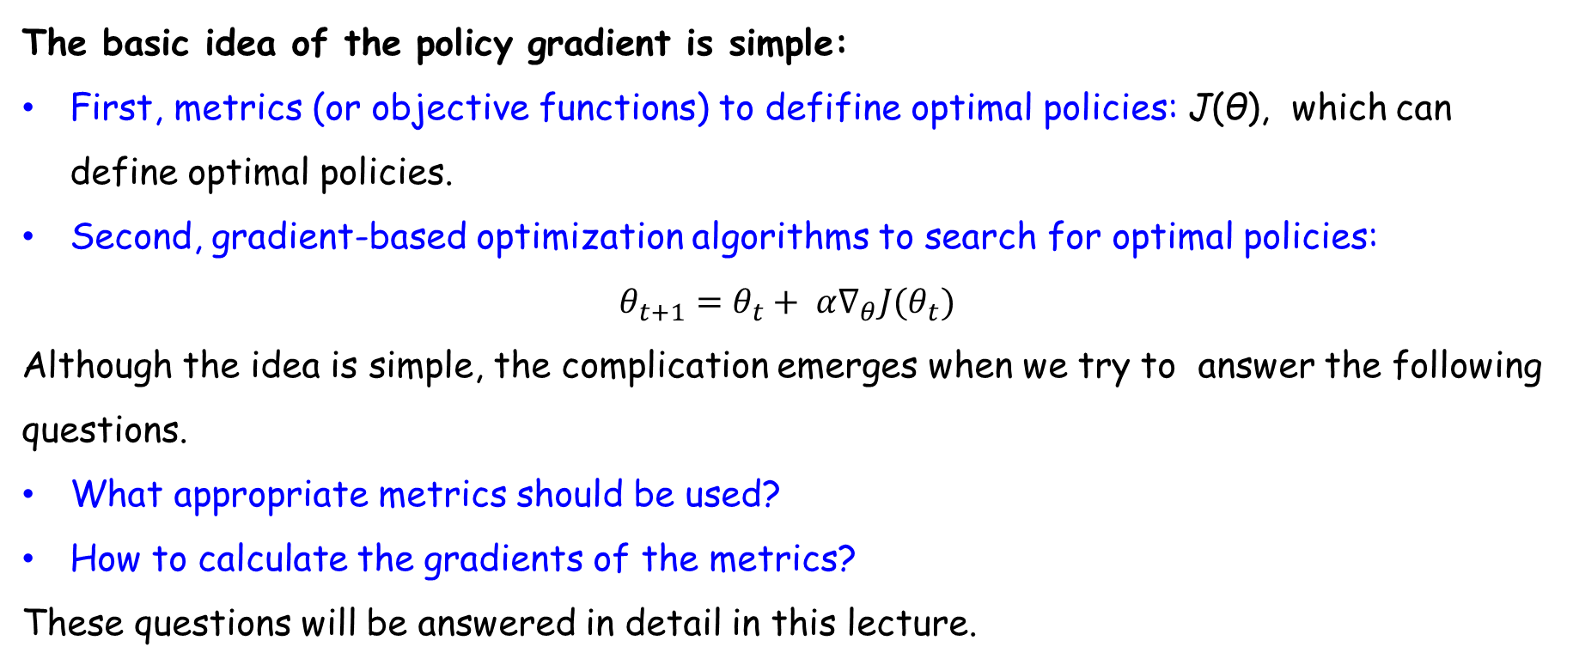
Basic idea of policy gradient
The basic idea of the policy gradient is simple:
First, metrics (or objective functions) to defifine optimal policies: J(θ), which can define optimal policies.
Second, gradient-based optimization algorithms to search for optimal policies:
$$θ_{t+1}=θ_{t}+ α∇_{θ}J(θ_{t})$$
Although the idea is simple, the complication emerges when we try to answer the following questions.
What appropriate metrics should be used?
How to calculate the gradients of the metrics?
These questions will be answered in detail in this lecture.

Slide 9
1
Basic idea of policy gradient
2
Metrics to define optimal policies
3
Gradients of the metrics
4
Gradient-ascent algorithm （REINFORCE）
5
Policy-based algorithms
6
Summary

Slide 10
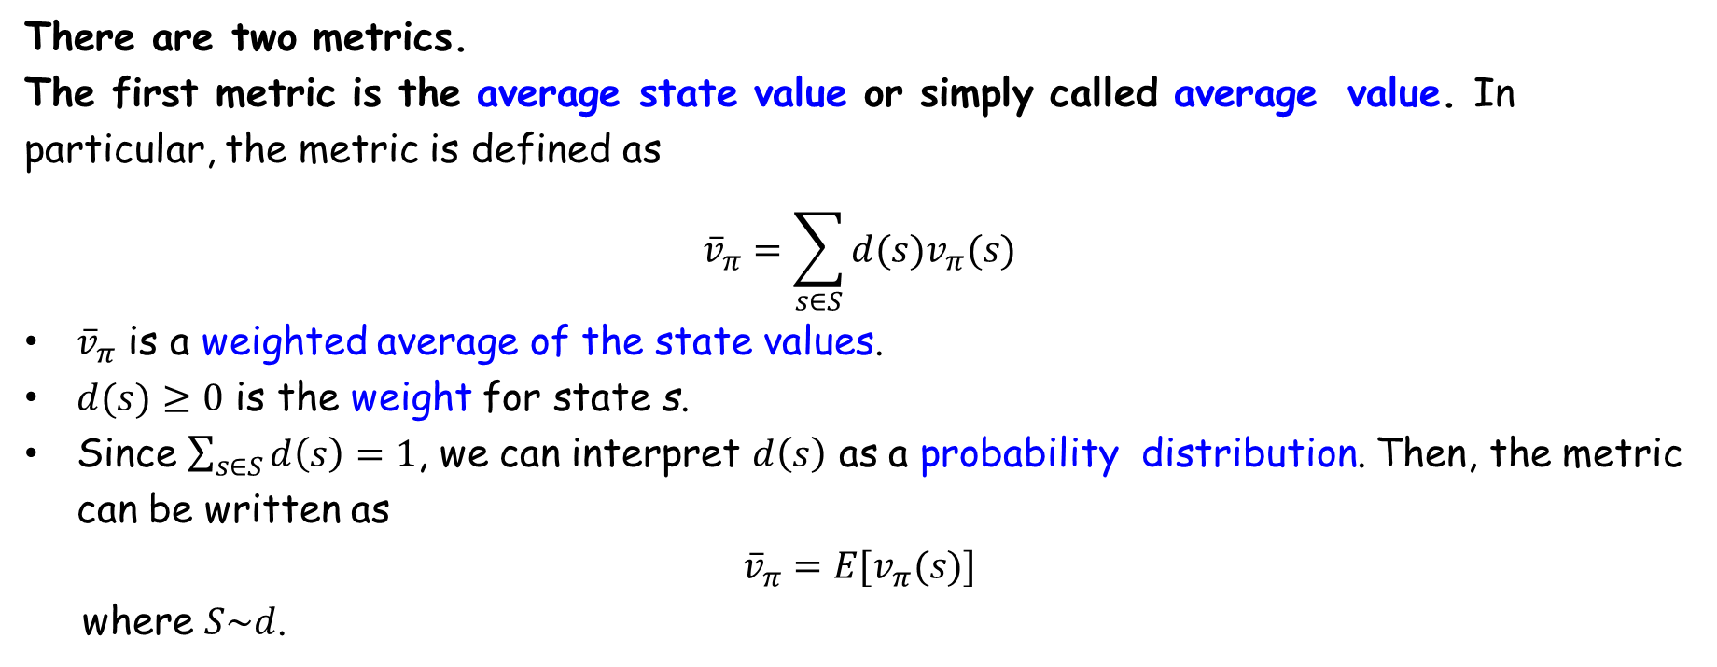
Metrics to define optimal policies - 1) The average value
There are two metrics.
The first metric is the average state value or simply called average value. In particular, the metric is defined as
$${\overline{v}}_{π}=\sum_{s∈S}{d(s)v_{π}(s)}$$
${\overline{v}}_{π}$ is a weighted average of the state values.
$d(s)≥0$ is the weight for state s.
Since $\sum_{s∈S}{d\left(s\right)=1}$, we can interpret $d\left(s\right)$ as a probability distribution. Then, the metric can be written as
$${\overline{v}}_{π}=E[v_{π}(s)]$$
where $S\sim d$.

Slide 11
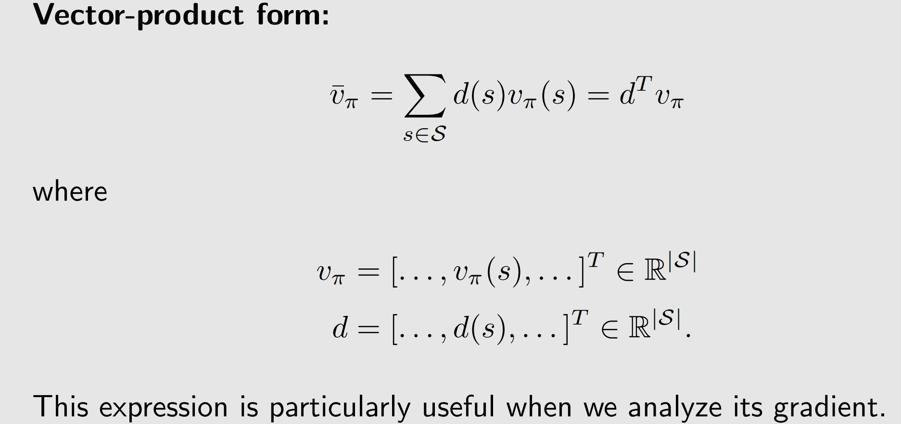
Metrics to define optimal policies - 1) The average value

Slide 12
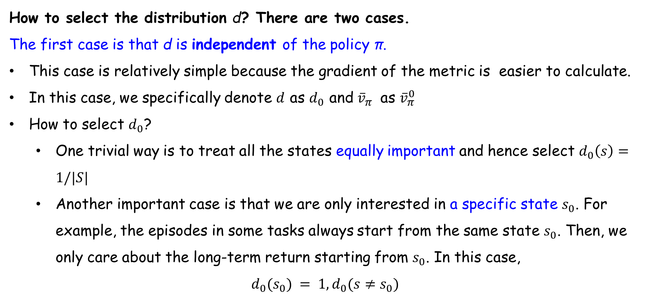
Metrics to define optimal policies - 1) The average value
How to select the distribution d? There are two cases.
The first case is that d is independent of the policy π.
This case is relatively simple because the gradient of the metric is easier to calculate.
In this case, we specifically denote $d$ as $d_{0}$ and ${\overline{v}}_{π}$ as ${\overline{v}}_{π}^{0}$
How to select $d_{0}$?
One trivial way is to treat all the states equally important and hence select $d_{0}\left(s\right)=1/|S|$
Another important case is that we are only interested in a specific state $s_{0}$. For example, the episodes in some tasks always start from the same state $s_{0}$. Then, we only care about the long-term return starting from $s_{0}$. In this case,
$$d_{0}(s_{0}) = 1,d_{0}(s≠s_{0})$$

Slide 13
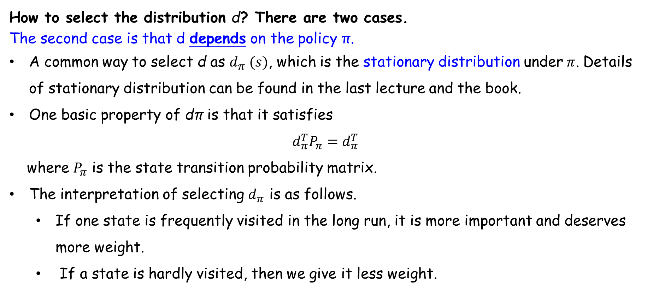
Metrics to define optimal policies - 1) The average value
How to select the distribution d? There are two cases.
The second case is that d depends on the policy π.
A common way to select d as $d_{π} (s)$, which is the stationary distribution under$π$. Details of stationary distribution can be found in the last lecture and the book.
One basic property of dπ is that it satisfies
$$d_{π}^{T}P_{π}=d_{π}^{T}$$
where $P_{π}$ is the state transition probability matrix.
The interpretation of selecting $d_{π}$ is as follows.
If one state is frequently visited in the long run, it is more important and deserves more weight.
If a state is hardly visited, then we give it less weight.

Slide 14
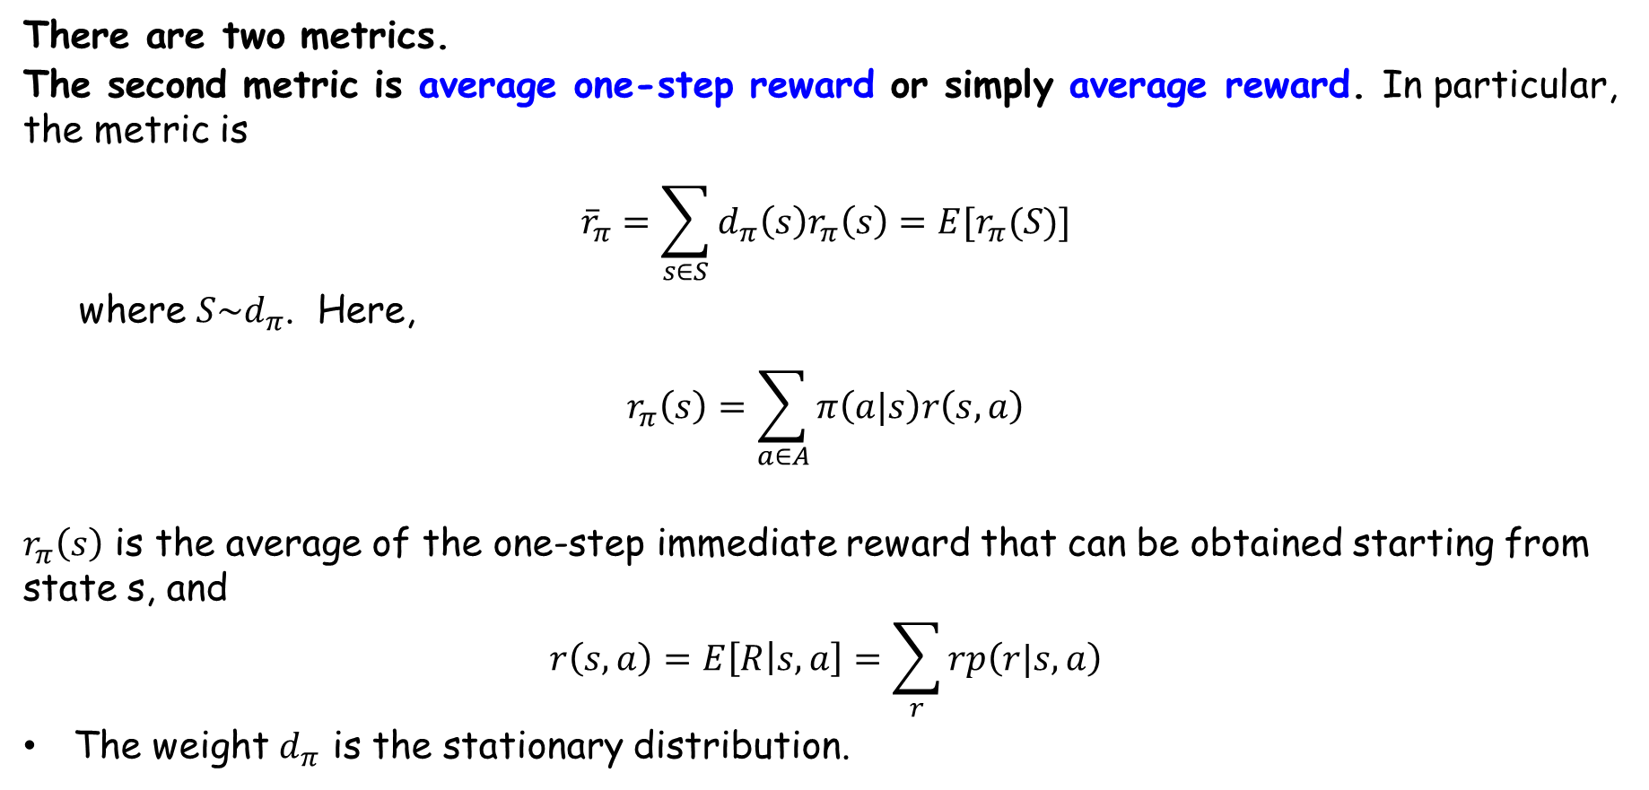
Metrics to define optimal policies - 2) The average reward
There are two metrics.
The second metric is average one-step reward or simply average reward. In particular, the metric is
$${\overline{r}}_{π}=\sum_{s∈S}{d_{π}\left(s\right)r_{π}\left(s\right)=E[r_{π}(S)]}$$
where $S\sim d_{π}$. Here,
$$r_{π}\left(s\right)=\sum_{a∈A}{π\left(a|s\right)r\left(s,a\right)}$$
$r_{π}\left(s\right)$ is the average of the one-step immediate reward that can be obtained starting from state s, and
$$r\left(s,a\right)=E\left[R | s,a\right]=\sum_{r}{rp\left(r|s,a\right)}$$
The weight $d_{π}$ is the stationary distribution.

Slide 15
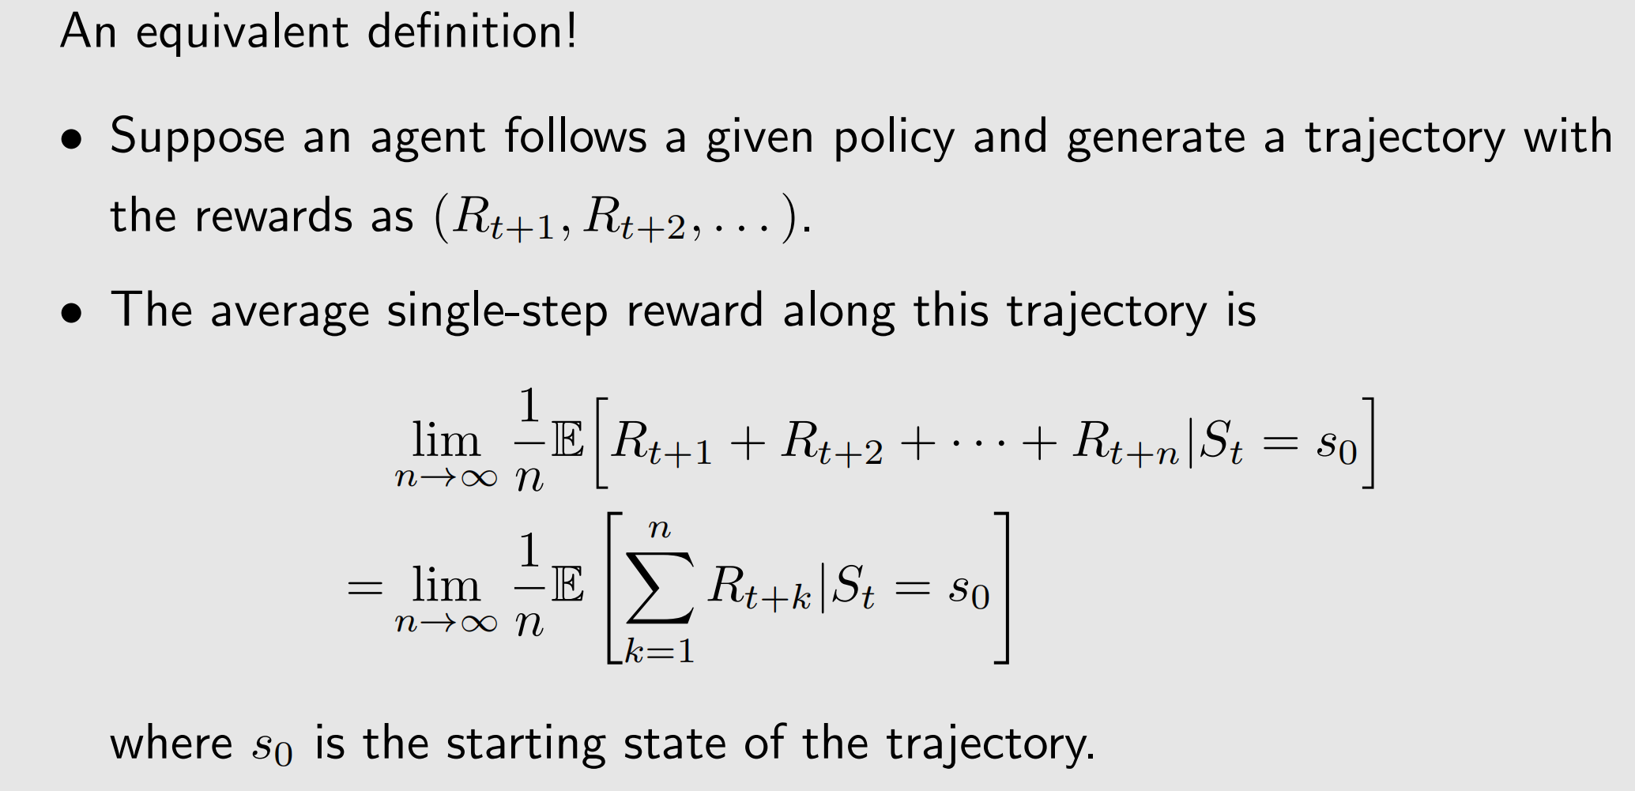
Metrics to define optimal policies - 2) The average reward

Slide 16
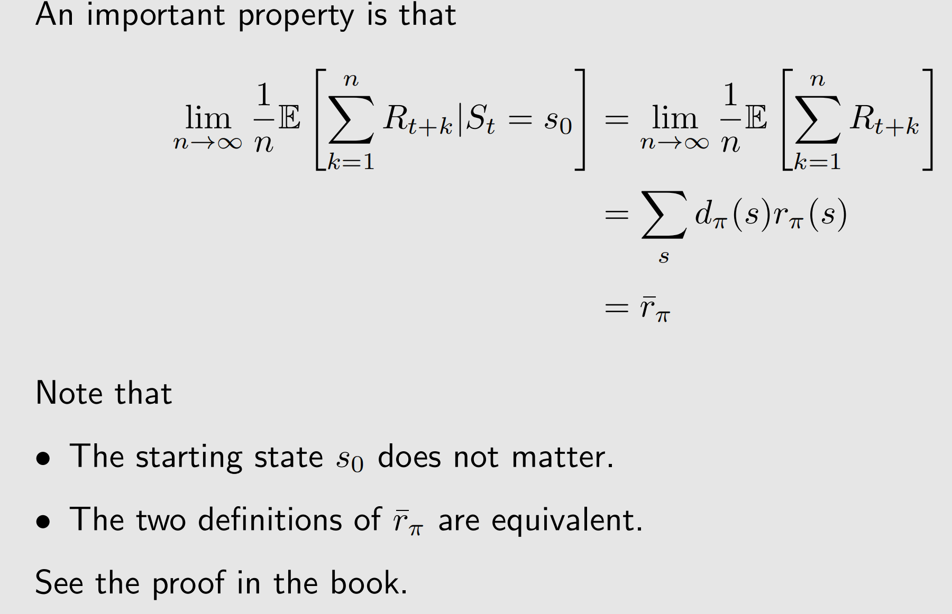
Metrics to define optimal policies - Remarks

Slide 17
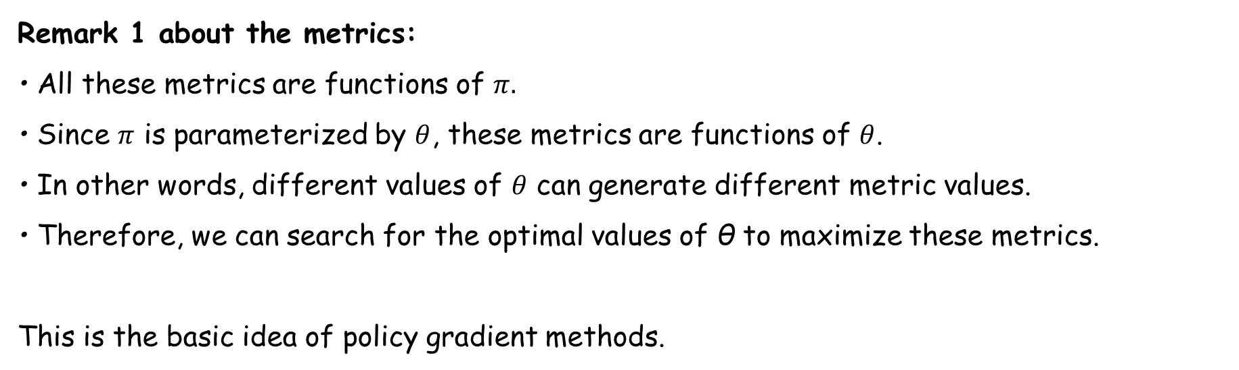
Metrics to define optimal policies - Remarks
Remark 1 about the metrics:
• All these metrics are functions of $π.$
• Since $π$ is parameterized by $θ$, these metrics are functions of $θ$.
• In other words, different values of $θ$ can generate different metric values.
• Therefore, we can search for the optimal values of θ to maximize these metrics.
This is the basic idea of policy gradient methods.

Slide 18
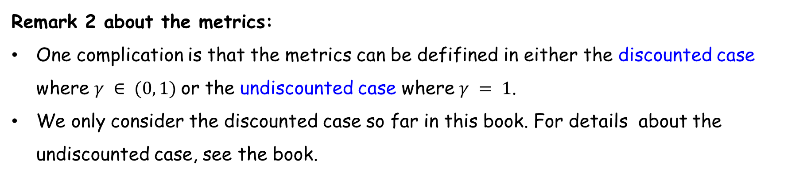
Metrics to define optimal policies - Remarks
Remark 2 about the metrics:
One complication is that the metrics can be defifined in either the discounted case where $γ ∈ (0, 1)$or the undiscounted case where $γ = 1$.
We only consider the discounted case so far in this book. For details about the undiscounted case, see the book.

Slide 19
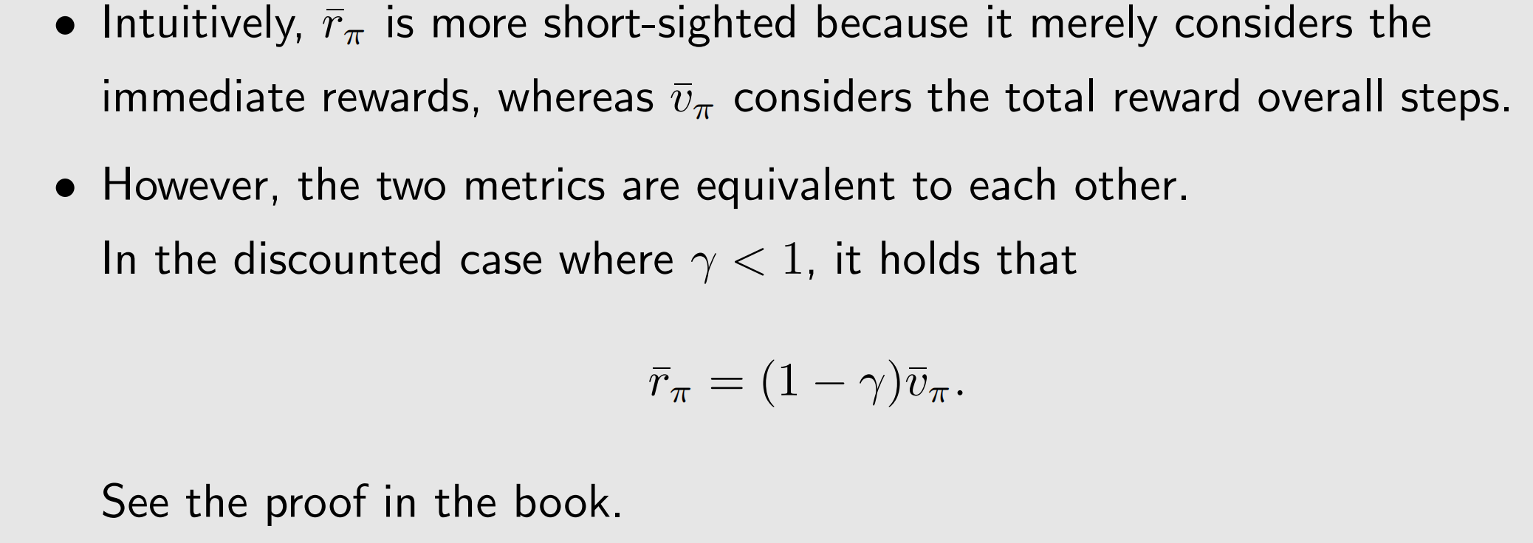
Metrics to define optimal policies - Remarks
Remark 3 about the metrics:

Slide 20
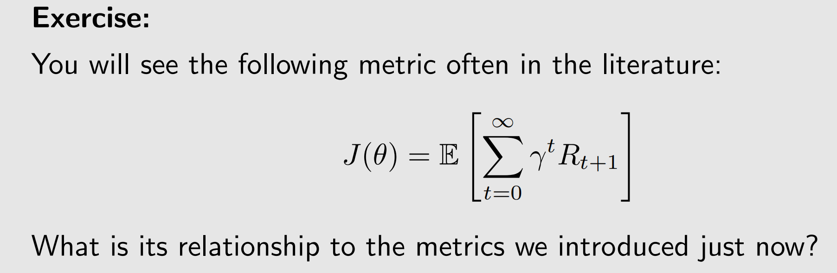
Metrics to define optimal policies - Exercise

Slide 21
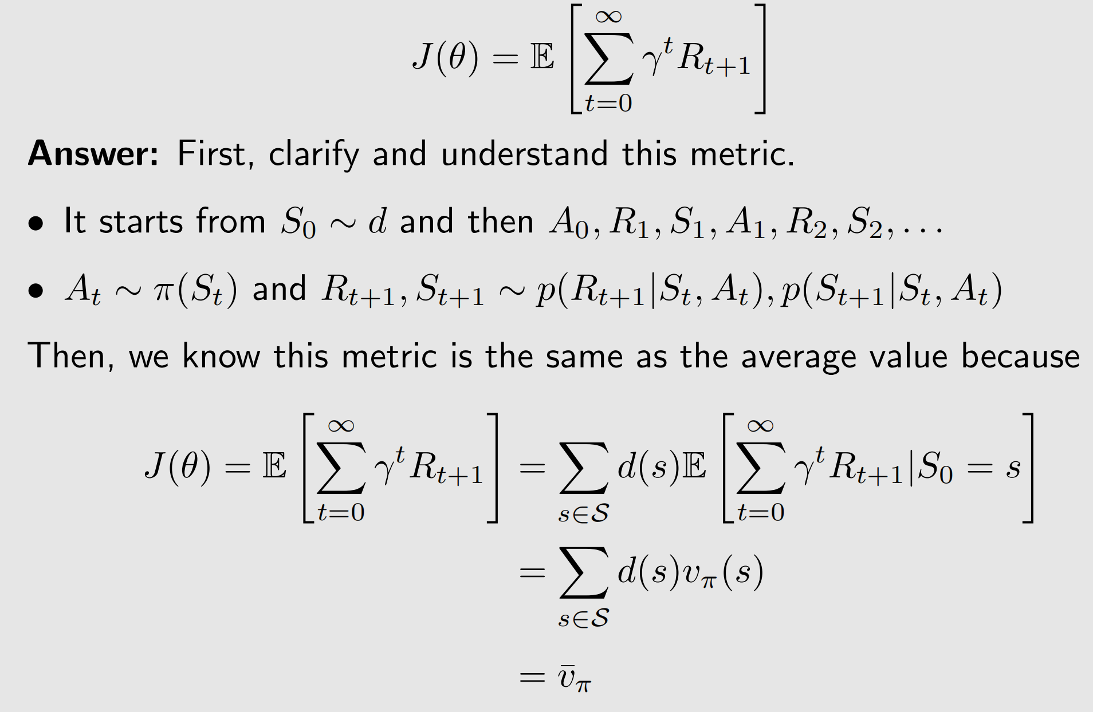
Metrics to define optimal policies - Exercise

Slide 22
1
Basic idea of policy gradient
2
Metrics to define optimal policies
3
Gradients of the metrics
4
Gradient-ascent algorithm （REINFORCE）
5
Policy-based algorithms
6
Summary

Slide 23
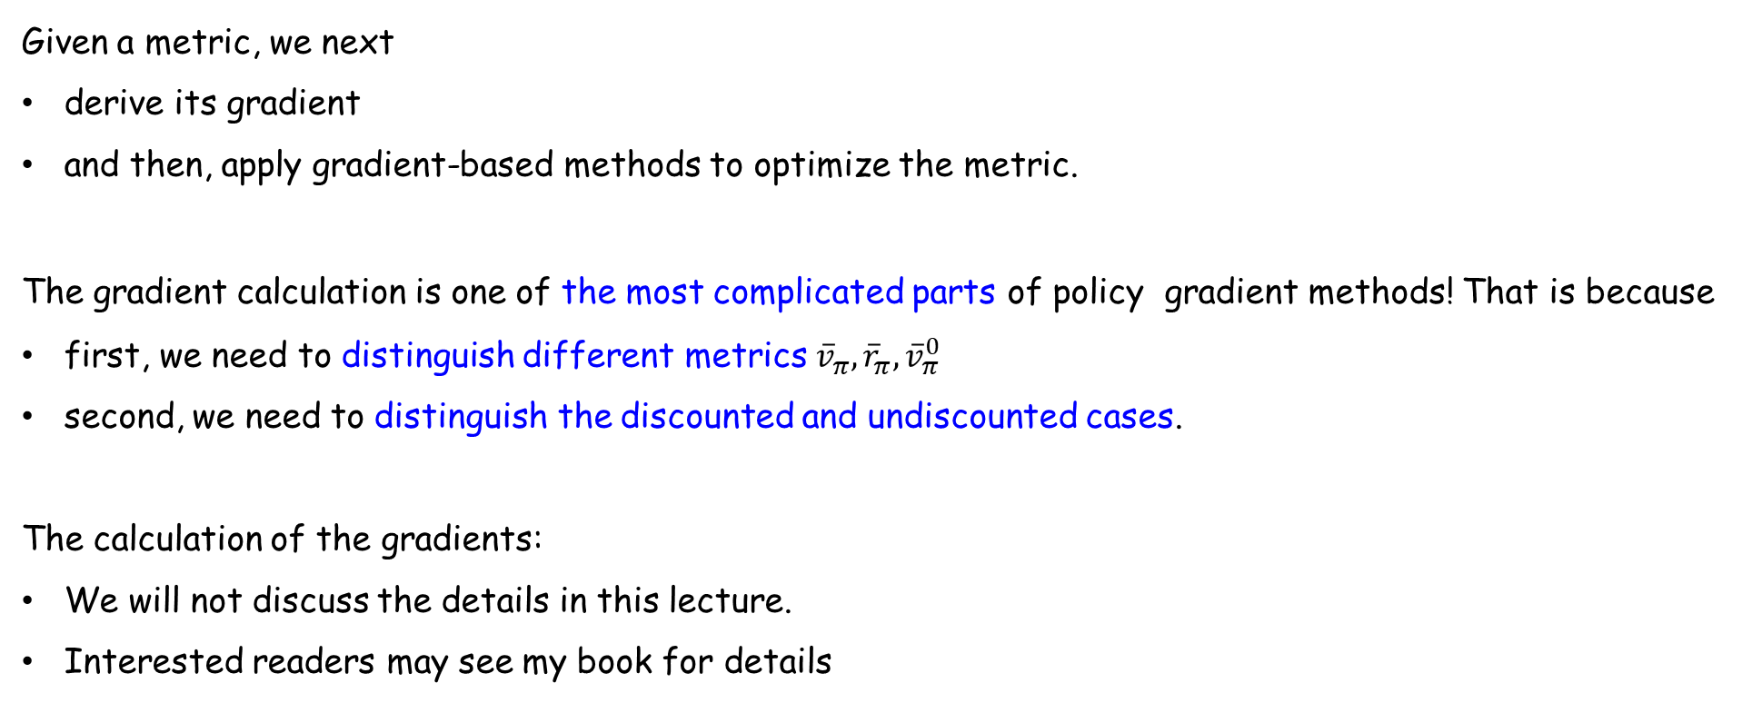
Gradients of the metrics
Given a metric, we next
derive its gradient
and then, apply gradient-based methods to optimize the metric.
The gradient calculation is one of the most complicated parts of policy gradient methods! That is because
first, we need to distinguish different metrics ${\overline{v}}_{π},{\overline{r}}_{π}, {\overline{v}}_{π}^{0}$
second, we need to distinguish the discounted and undiscounted cases.
The calculation of the gradients:
We will not discuss the details in this lecture.
Interested readers may see my book for details

Slide 24
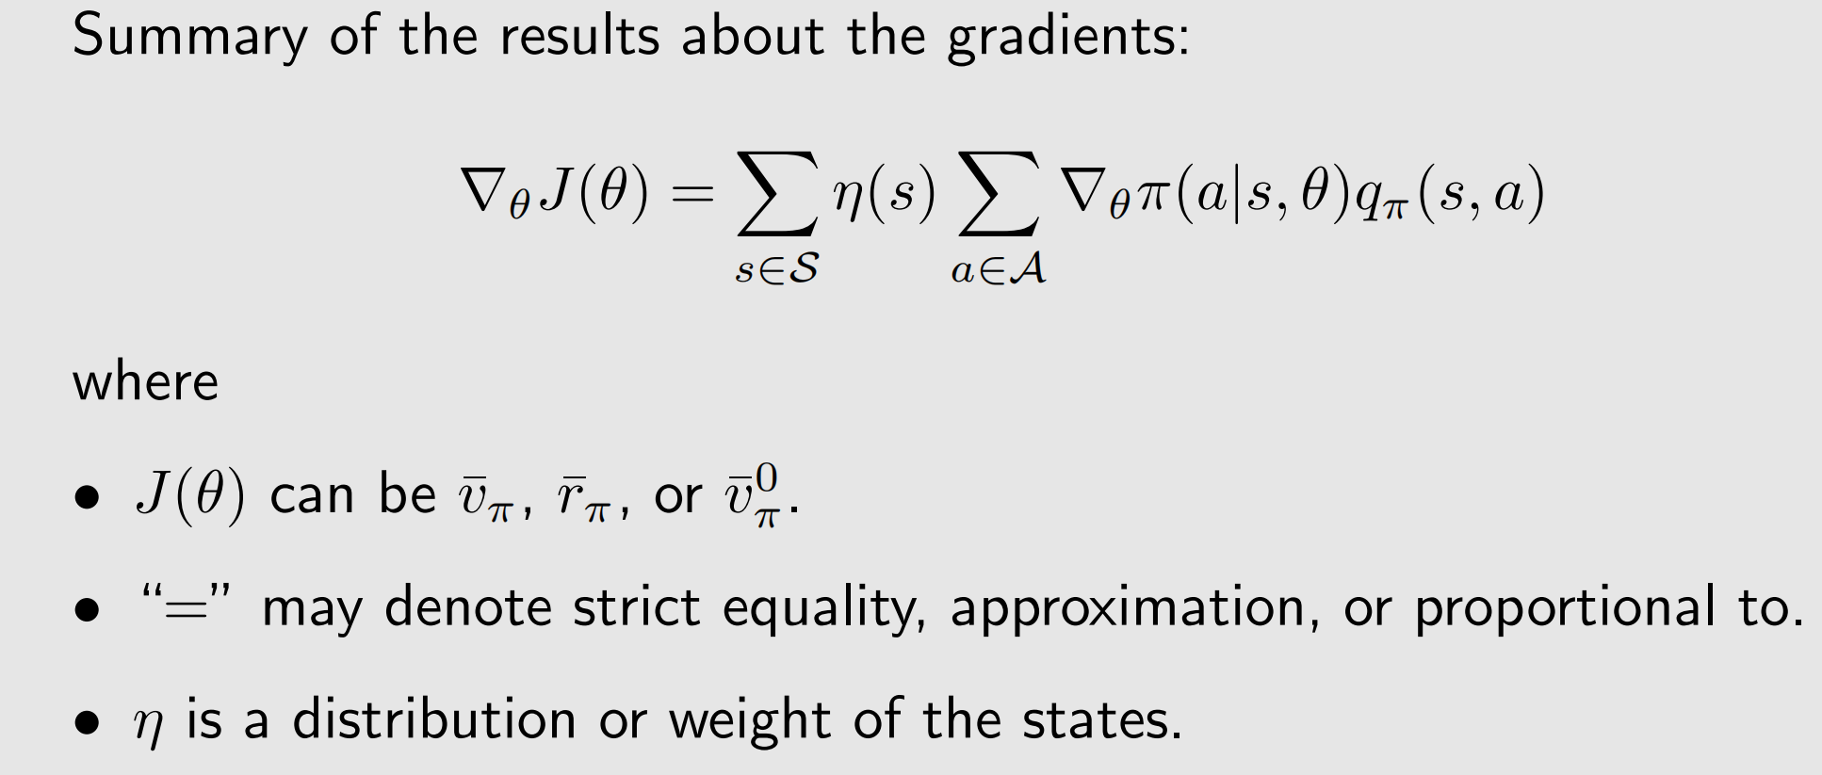
Gradients of the metrics

Slide 25
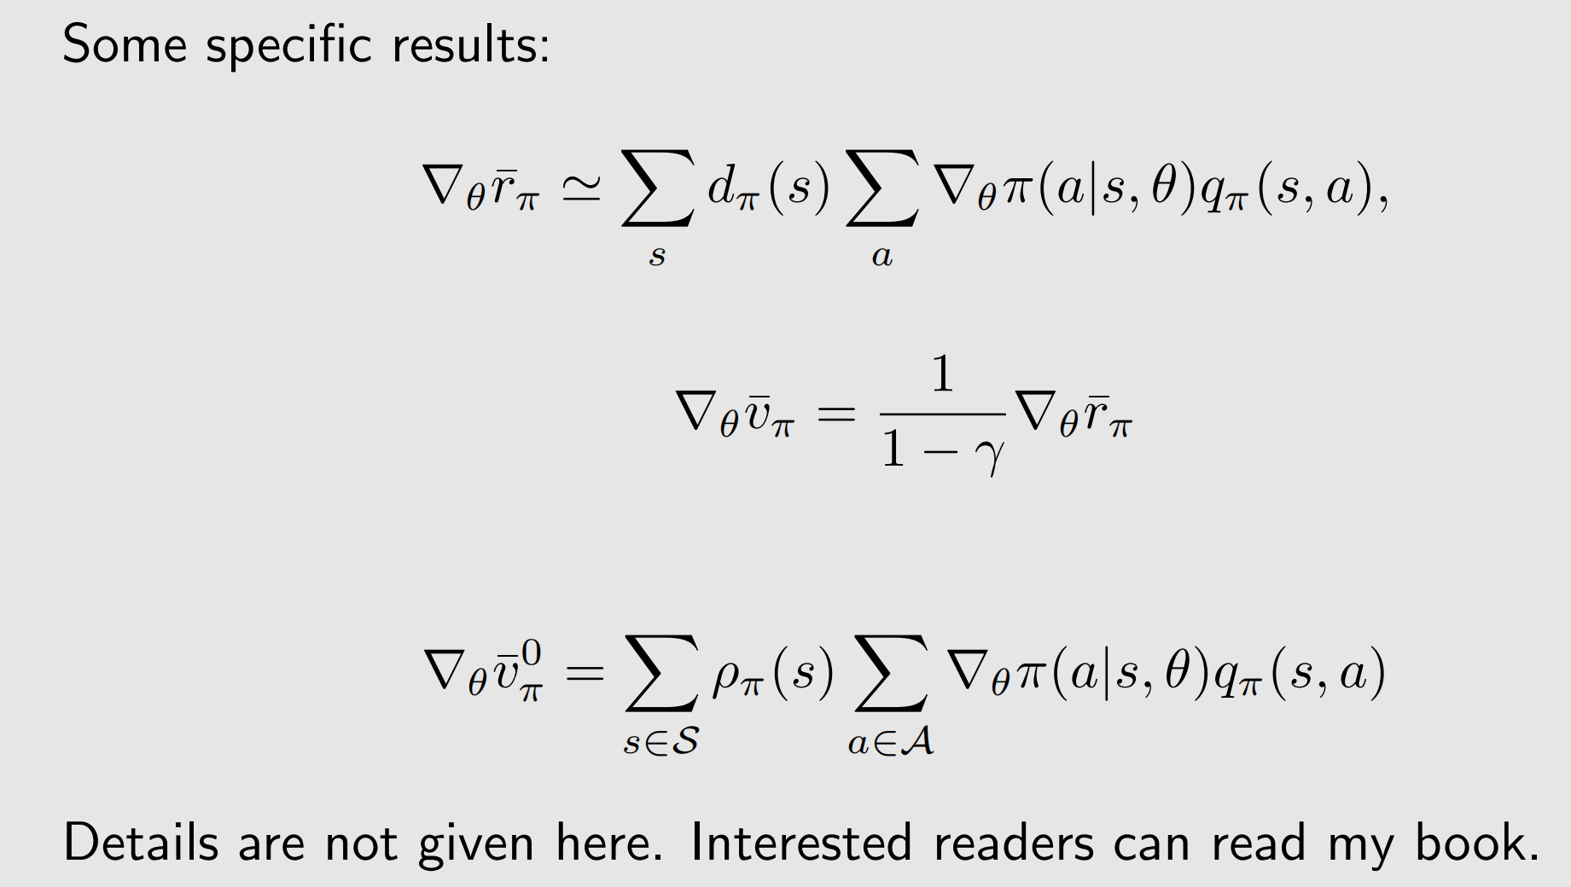
Gradients of the metrics

Slide 26
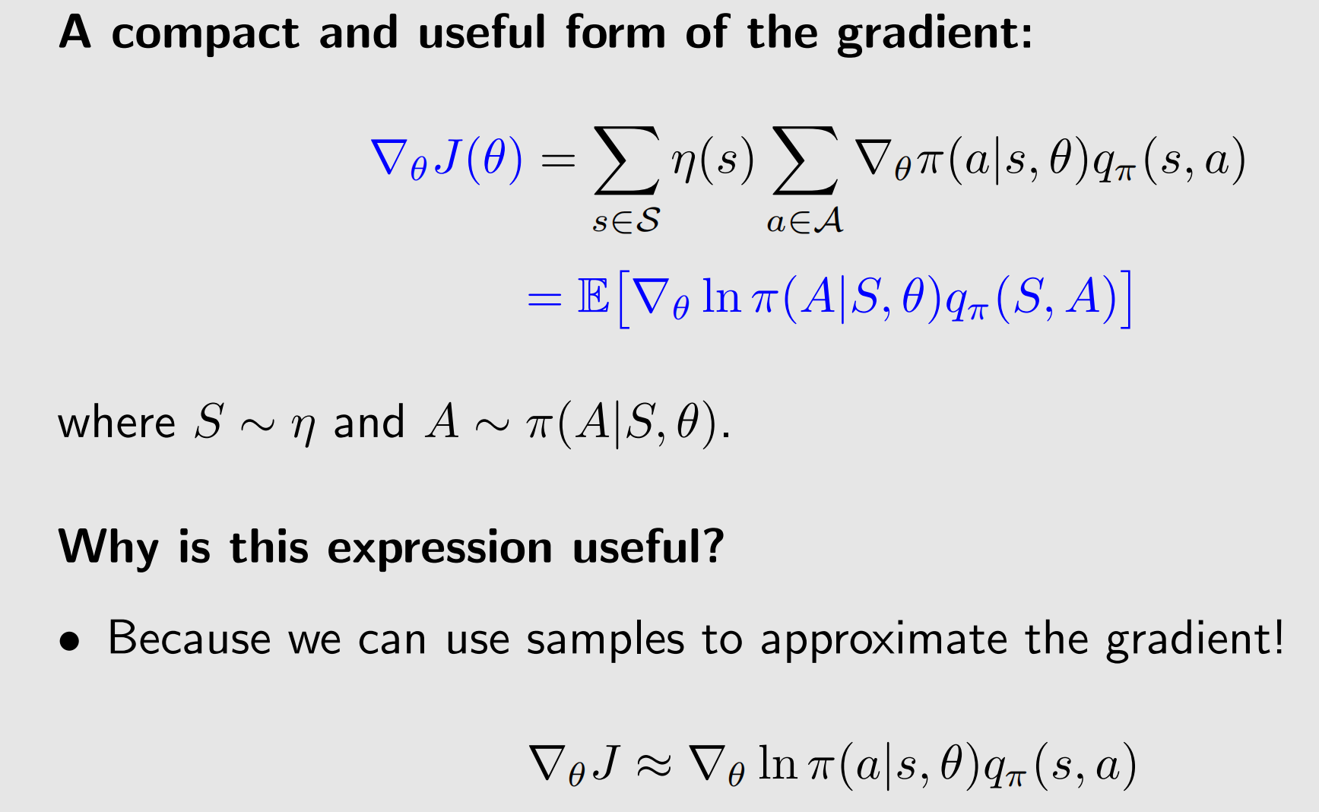
Gradients of the metrics

Slide 27
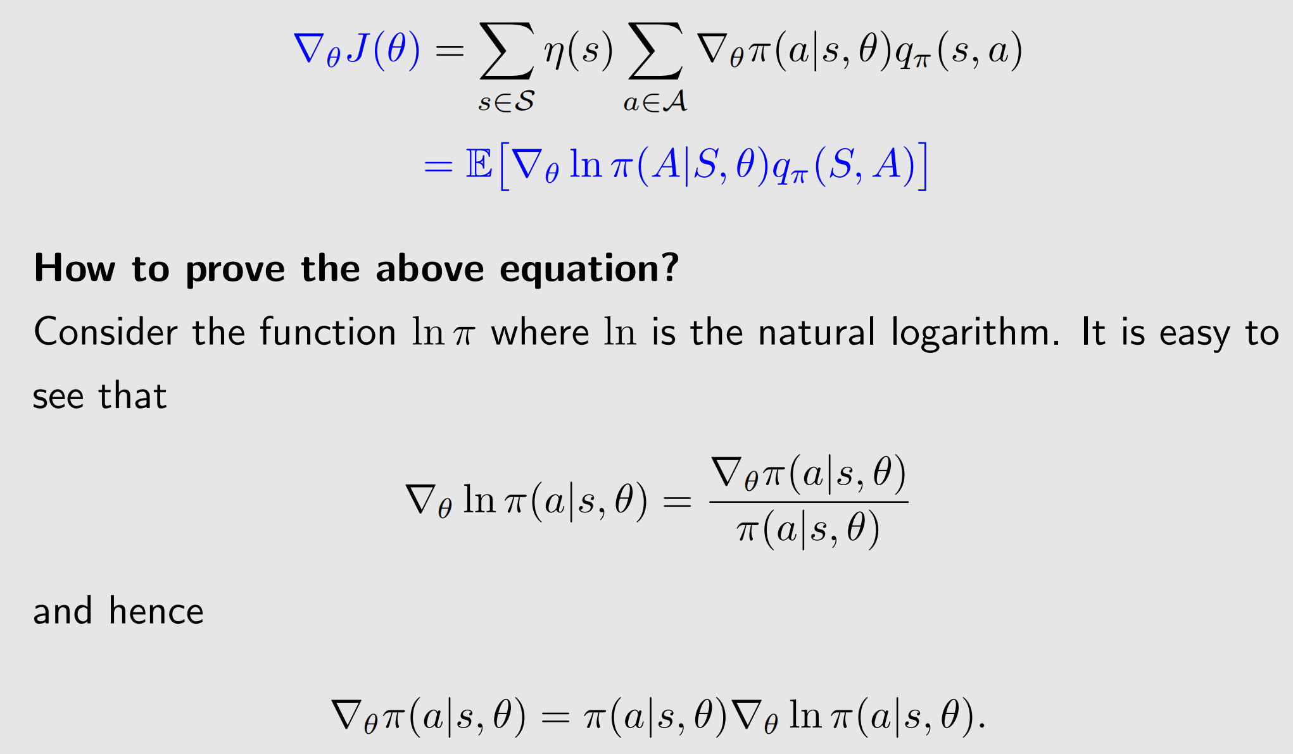
Gradients of the metrics

Slide 28
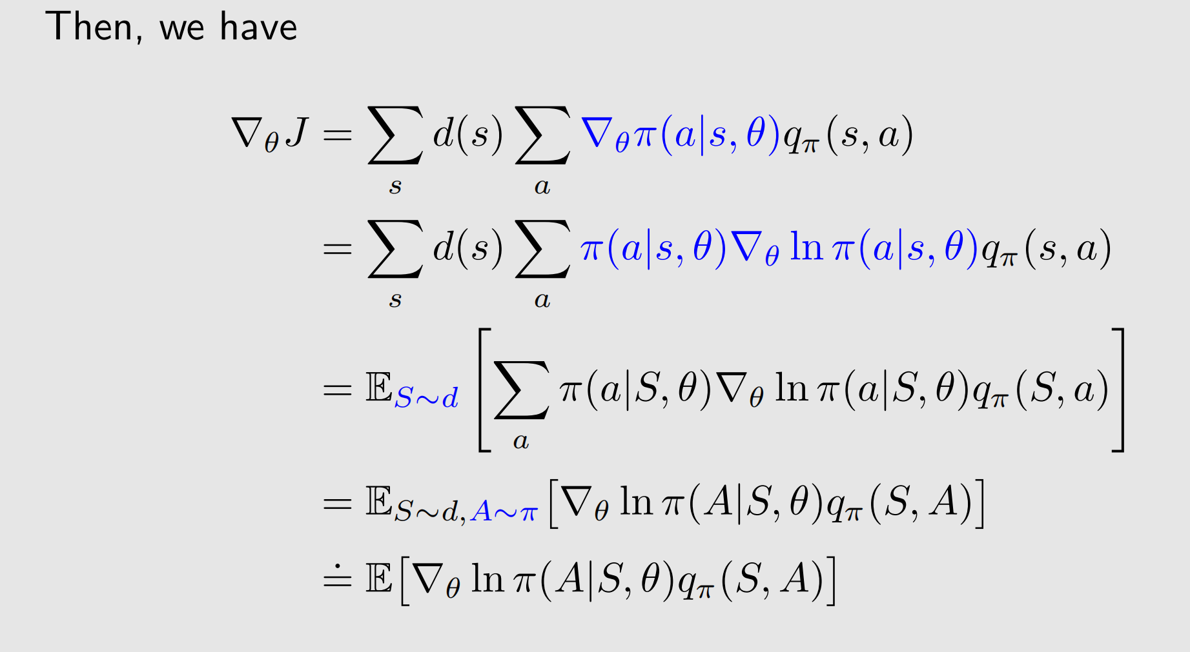
Gradients of the metrics

Slide 29
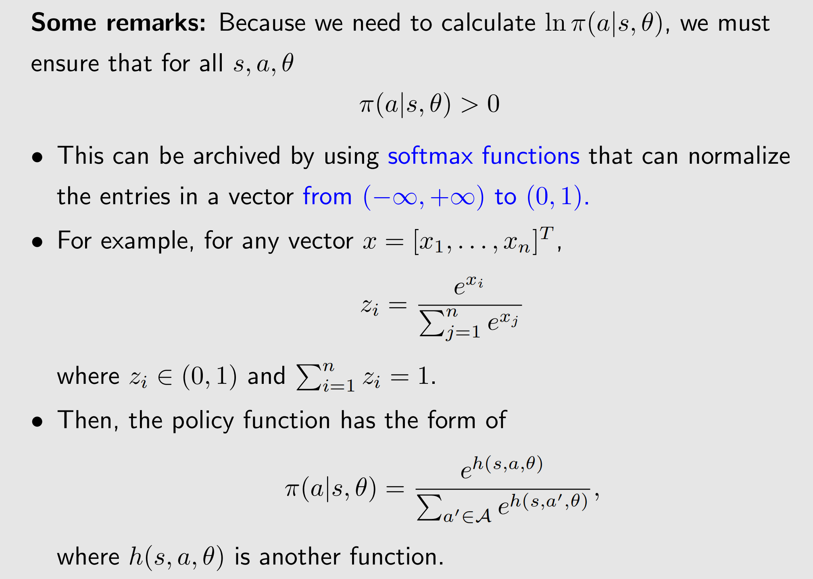
Gradients of the metrics

Slide 30
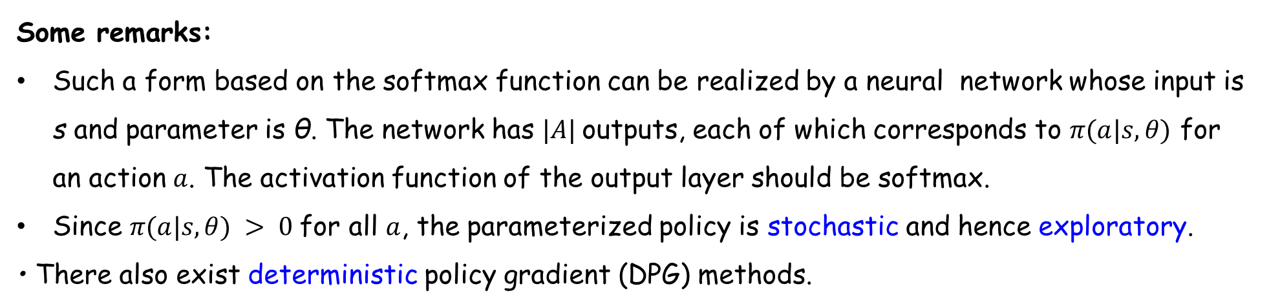
Gradients of the metrics
Some remarks:
Such a form based on the softmax function can be realized by a neural network whose input is s and parameter is θ. The network has $|A|$outputs, each of which corresponds to $π(a|s, θ)$ for an action $a$. The activation function of the output layer should be softmax.
Since $π(a|s, θ) > 0$for all $a$, the parameterized policy is stochastic and hence exploratory.
• There also exist deterministic policy gradient (DPG) methods.

Slide 31
1
Basic idea of policy gradient
2
Metrics to define optimal policies
3
Gradients of the metrics
4
Gradient-ascent algorithm （REINFORCE）
5
Policy-based algorithms
6
Summary

Slide 32
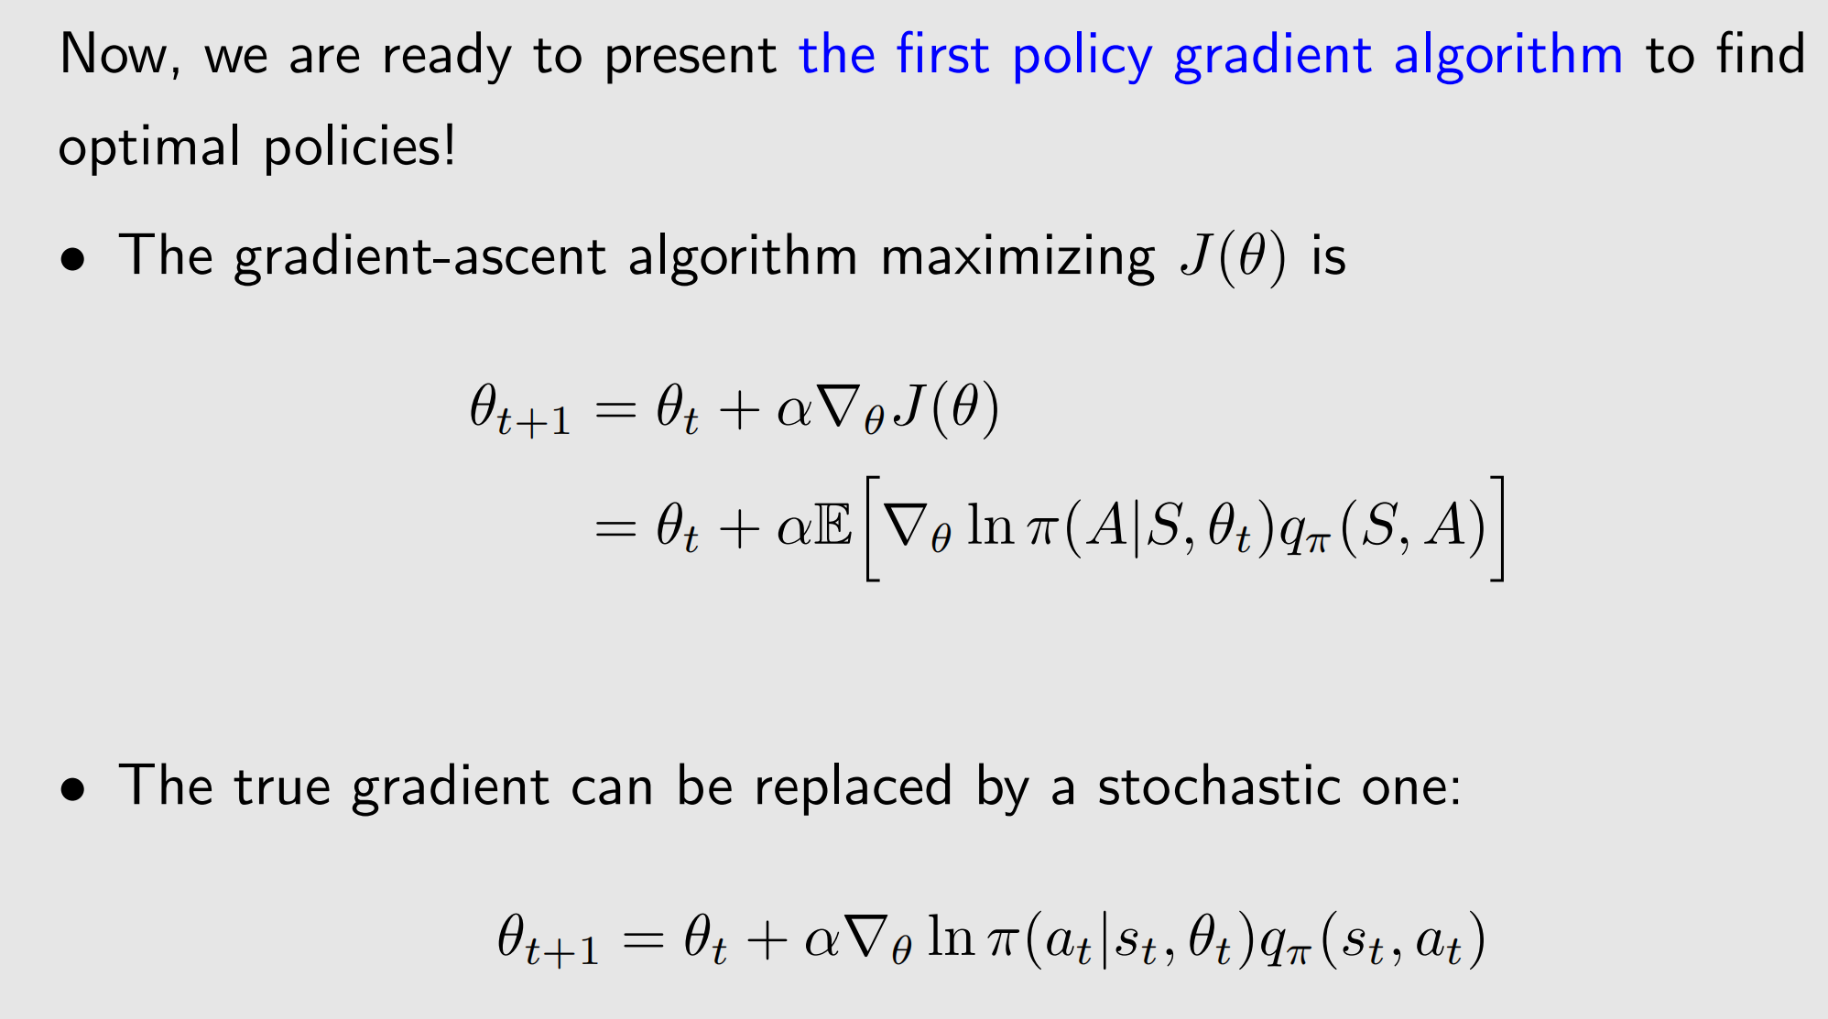
Gradient-ascent algorithm

Slide 33
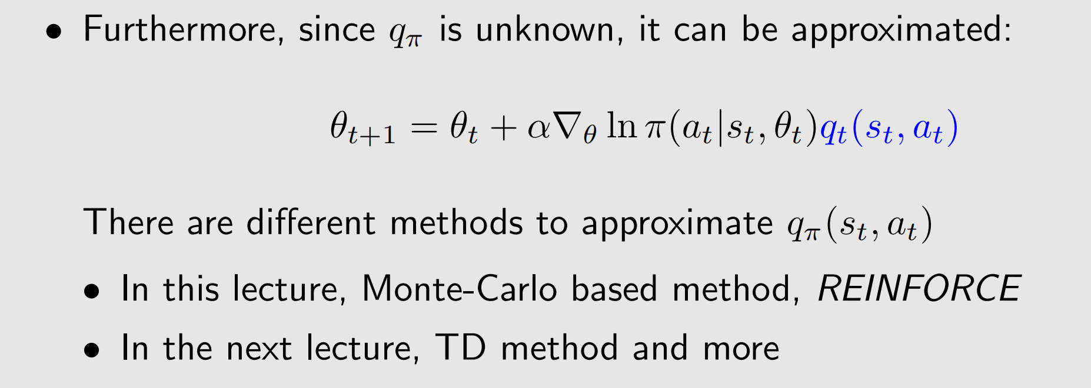
Gradient-ascent algorithm

Slide 34
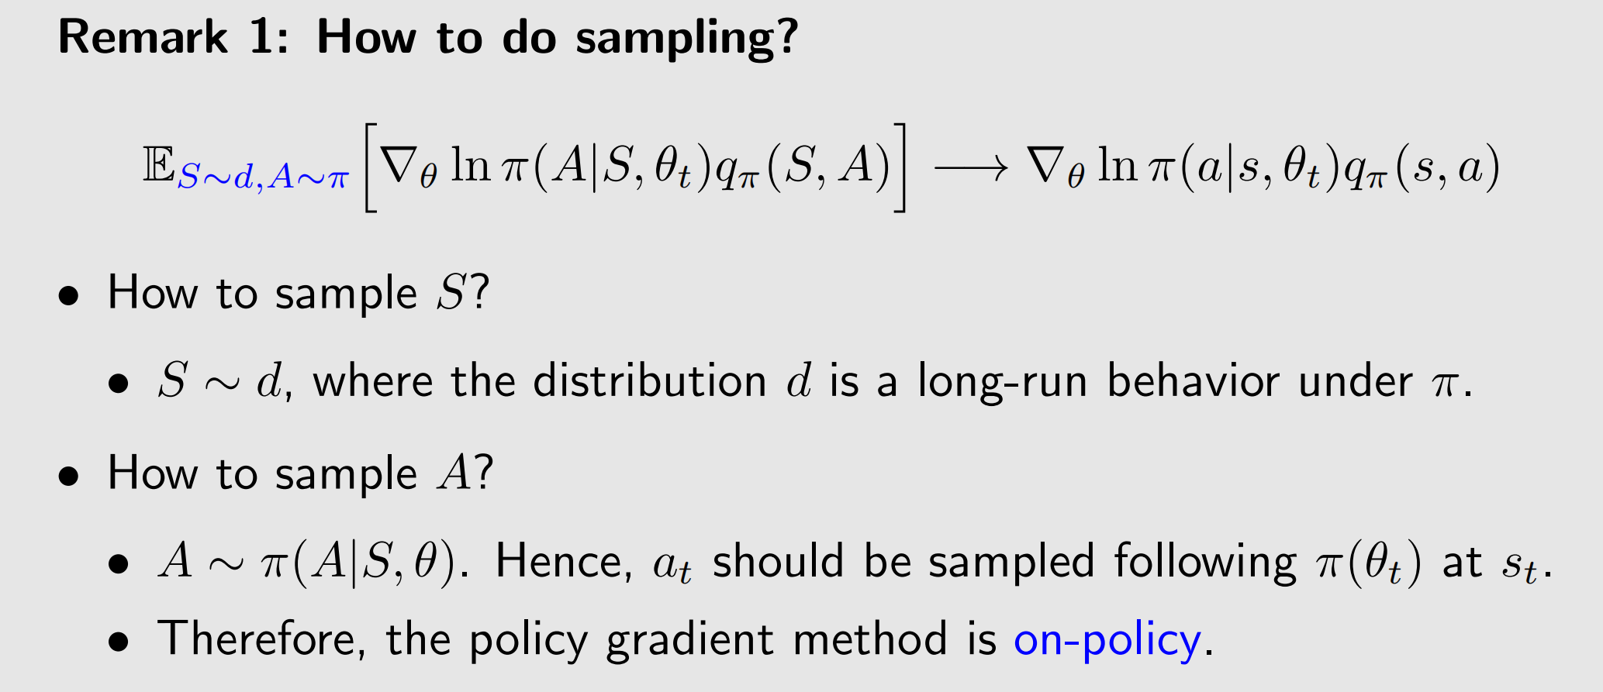
Gradient-ascent algorithm

Slide 35
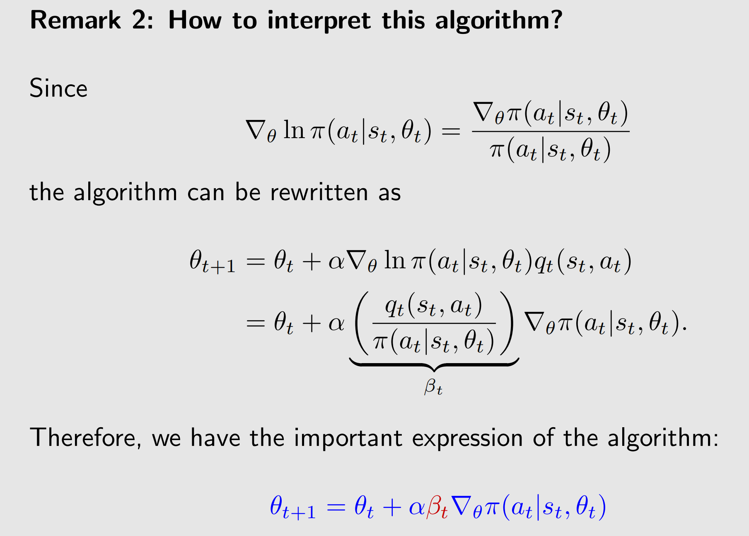
Gradient-ascent algorithm

Slide 36
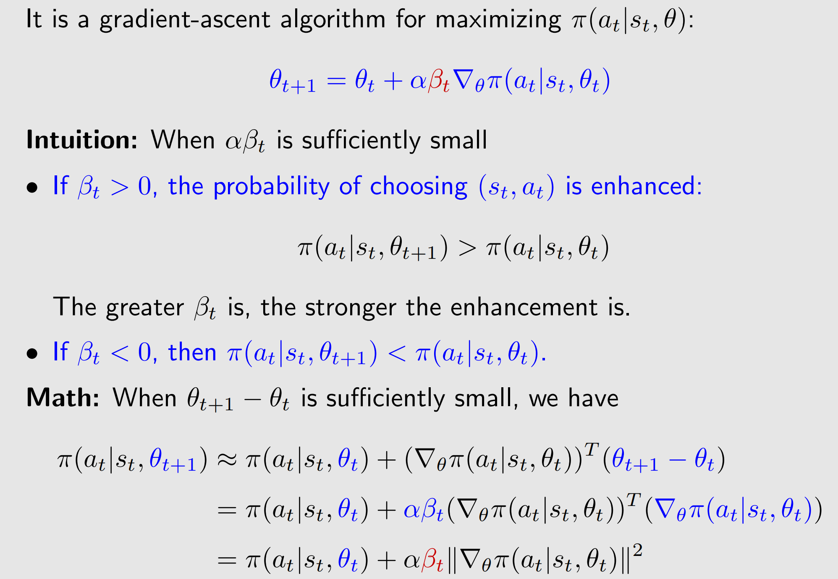
Gradient-ascent algorithm

Slide 37
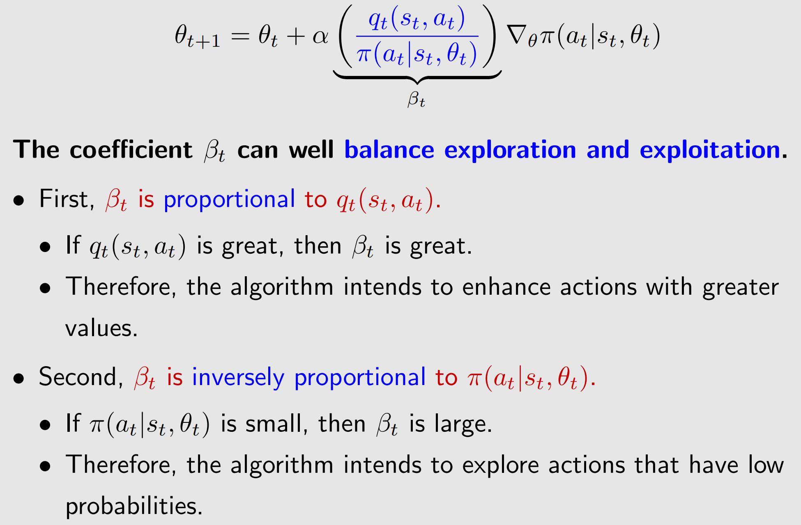
Gradient-ascent algorithm

Slide 38
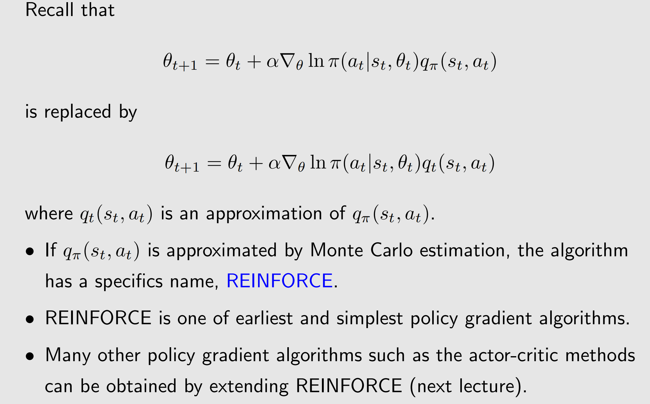
REINFORCE algorithm

Slide 39
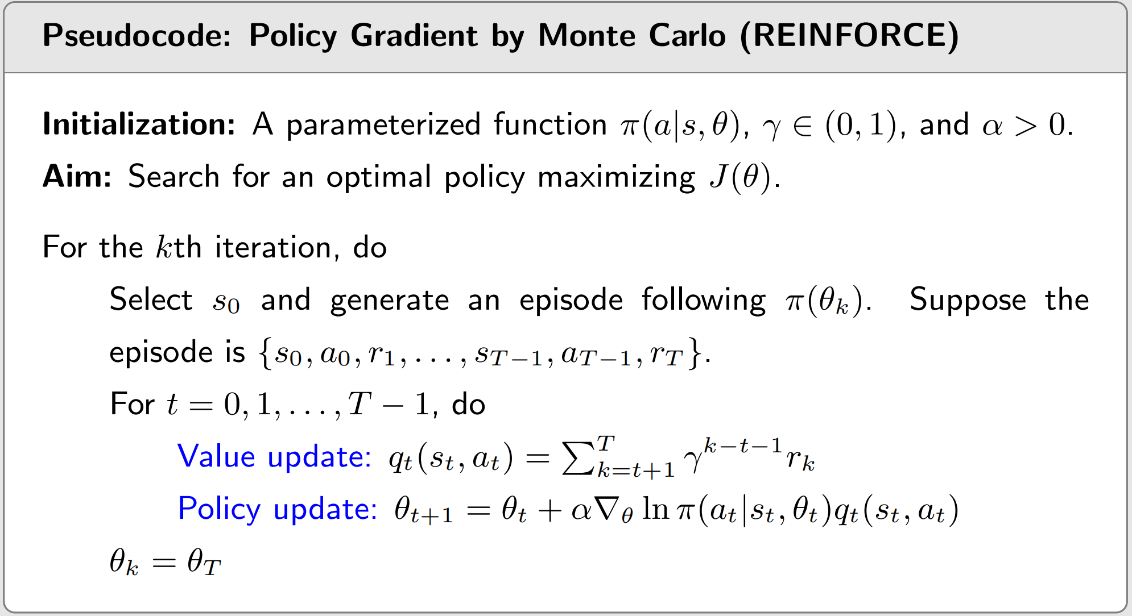
REINFORCE algorithm

Slide 40
1
Basic idea of policy gradient
2
Metrics to define optimal policies
3
Gradients of the metrics
4
Gradient-ascent algorithm （REINFORCE）
5
Policy-based algorithms
6
Summary

Slide 41
REINFORCE algorithm

Slide 42
1
Basic idea of policy gradient
2
Metrics to define optimal policies
3
Gradients of the metrics
4
Gradient-ascent algorithm （REINFORCE）
5
Policy-based algorithms
6
Summary

Slide 43
Summary
Contents of this lecture:
• Metrics for optimality
• Gradients of the metrics
• Gradient-ascent algorithm
• A special case: REINFORCE
Next lecture: Actor-critic

Slide 44


Any Questions？

